Slide 1


Danish Nurhira Putra
19/ September/ 2024

Slide 2
Outline
Executive Summary
Introduction
Methodology
Results
Conclusion
Appendix

Slide 3
Executive Summary
Summary of methodologies
Data was collected using a combination of a Wikipedia website and a SpaceX API. Numpy, pandas, sci-kit learn, seaborn, SQL, Matplotlib, Folium, and Dash were all used to wrangle, clean, explore, visualize and create predictive models to determine landing outcomes of the Falcon 9 rockets.
Summary of Results
The FT rocket booster has the highest success rate for landing outcomes compared to all other boosters, especially with a payload mass of 2000 to 4000 kg. KSC LC-39A has shown to have the highest chance of a successful landing compared to the other sites. Combining these two observations could yield a reliable outcome for landing success.

Slide 4
Introduction
For most of history, rockets have been single use rockets. Designing a rocket that can land the first stage of the rocket for reuse can greatly reduce the waste and cost for future space flights. This project analyzes Falcon 9 launch data to predict if the first stage of the rocket will land successfully. The ability to predict the success of a landing outcome can narrow the variables that have the highest impact on successful landings.
We would like to answer in this project, what variables have the greatest impact on landing success? Is there a specific launch site that has a higher landing success rate? What rocket booster versions have the highest success? Does the mass of the payload being carried impact landing success? How does the flight orbit affect landing outcomes?

Slide 5

Section 1
5

Slide 6
Methodology
Executive Summary
Data collection methodology:
Web scraping from Wikipedia – List of Falcon 9 and Falcon Heavy Launches
Web scraping from SpaceX API
Perform data wrangling
Determined number and occurrence of launches, orbits, and outcomes
Perform exploratory data analysis (EDA) using visualization and SQL
Perform interactive visual analytics using Folium and Plotly Dash
Perform predictive analysis using classification models

Slide 7
Data Collection
Data was collected by using a get requests on a SpaceX API and a Wikipedia page. Functions were used to parse the data and build that data into dataframes. SpaceX API data needed to be filtered to only include Falcon 9 data as this was the focus of this project.
Get Request
Build Dataframe
Parse Data
Filter Data

Slide 8
Data Collection – SpaceX API
Capstone-Project-Coursera/SpaceX Data Collection.ipynb at main · DanishNurhira/Capstone-Project-Coursera (github.com)
Get Request
Build Dataframe
Parse Data
Build New Dataframe
with Parsed Data
Filter Dataframe for Falcon 9 only

Slide 9
Data Collection - Scraping
Get Request
Parse HTML data with BeautifulSoup
Capstone-Project-Coursera/SpaceX Webscraping.ipynb at main ·
Find Table
Extract Column Headers to List
Create Dictionary with Column Headers
Iterate FOR Loop to Extract Row Data for each Header and Append Dictionary

Slide 10
Data Wrangling
First, I checked the number of occurrences for each launch site and orbit. Next, I found the number of mission outcomes by string name. Creating a list of the failed outcomes, I assigned each outcome occurrence a 0 (failure) or 1 (successful), and assigned that to a landing class list. I appended the dataframe to include the landing class list.
Capstone-Project-Coursera/SpaceX Data Wrangling.ipynb at main · DanishNurhira/Capstone-Project-Coursera (github.com)
Value Count Launchsite Column
Value Count Outcome Column
Assign Failed Outcome Strings to a Set
Create landing_class list
Loop Set and Append List with 0 and 1
Add New landing_class List to Dataframe
Value Count Orbit Column

Slide 11
EDA with Data Visualization
Multiple scatter plots were made with the landing class as the color hue for each occurance. The scatter plots created were Flight Number vs (Payload Mass, Launch Site, and Orbit) and Payload Mass vs (Launch Site and Orbit). These plots were used to visually identify if there were any relationships between the columns of data.
A bar chart was created to determine which orbits had the highest success
rates with 4 having 100% success rates.
Finally, a line plot was created to determine the success rate for flights between 2010 and 2020.
Capstone-Project-Coursera/Exploring and Preparing Data Visualizations.ipynb at main · DanishNurhira/Capstone-Project-Coursera (github.com)
11

Slide 12
EDA with SQL
Listed each launch site
Pulled 5 rows of data for launch sites beginning with ‘CCA’
Calculated the total payload mass launched by NASA (CRS)
Found the average payload mass carried by F9 v1.1 booster
Found the first date when a successful ground pad landing occurred
Determined the booster versions with payloads between 4000-6000 kg and successful drone ship landing
outcomes
Found the total success and failure mission outcomes
Listed the booster that carried the heaviest payload mass
Listed records of the failed drone ship outcomes for the year of 2015
Ranked the landing outcomes by count between 6/4/2010 and 3/20/2017
Capstone-Project-Coursera/Data Exploration with SQLlite.ipynb at main · DanishNurhira/Capstone-Project-Coursera (github.com)

Slide 13
Build an Interactive Map with Folium
Launch sites were added to a folium map of the United States that detailed out how
many successful and failed landing outcomes occurred.
Each launch site also shows the distance to the nearest coast, railroad, highway, and city.
Each of these objects displays a lot of information in a relatively clean and
understandable fashion allowing the user to understand each site better.
Capstone-Project-Coursera/Folium Site Locations.ipynb at main · DanishNurhira/Capstone-Project-Coursera (github.com)

Slide 14
Build a Dashboard with Plotly Dash
Two plots were created using Plotly Dash: pie chart and scatter plot
The pie chart showed either the successful flights of all sites or each sites
success rate
The scatter plot showed the landing outcomes for either all sites or one by booster version and payload mass.
The payload mass, launch site, and booster versions showed varying degrees of influence on the landing outcome success. Combining all of these variables into interactive plots made it easier to see how each variable affected the outcome.
Capstone-Project-Coursera/spacex_dash_app.py at main · DanishNurhira/Capstone-Project-Coursera (github.com)

Slide 15
Predictive Analysis (Classification)
Each prediction model was built by comparing the landing outcome to the other standardized variables. The data were split into training and testing sets where 80% of the data were used to train each model.
The models used were linear regression, SVC, decision tree, and K-nearest neighbor. The models were created using GridSearchCV and the training data. The models were evaluated by their best parameters and their accuracy using best_params_ and best_score_. Confusion matrices were plotted to visualize the accuracy of the models.
Capstone-Project-Coursera/SpaceX_Machine Learning Prediction.ipynb at main · DanishNurhira/Capstone-Project-Coursera (github.com)
Create Array of Outcomes
Standardize data
Split data into training and testing data
Use GridSearchCV to train models
Evaluate models

Slide 16
Results
Exploratory data analysis showed that there were relationships between orbit,
payload mass, and launch site that affected the landing outcome.
The interactive analytics demonstrations further portrayed these relationships with greater insight and uncovered the affect of the booster version contributed to the success of landing.
The results of both the exploratory data analysis using Matplotlib and SQL and the interactive analytics using Folium and Plotly Dash showed that the highest probability of a successful landing was using an FT booster launched from KSC LC- 39A with a payload between 2000 to 4000 kg reaching orbits: ES-L1, GEO, HEO, or SSO.
All the predictive analytic models performed well with all predicting most of the landing outcomes correctly but all with 3 false positive landing outcomes.

Slide 17

Section 2

Slide 18
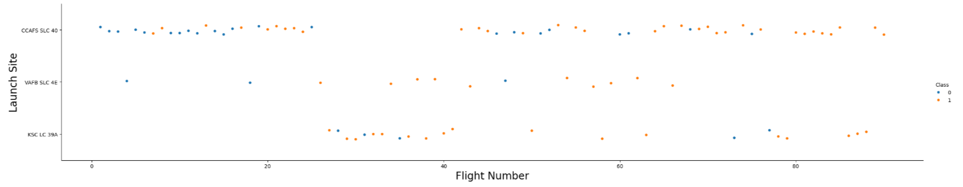
Flight Number vs. Launch Site
The plot above shows the successful (Orange) and unsuccessful (Blue) landing outcomes for 3 different launch sites (CCAFS SLC-40, VAFB SLC 4E, and KSC LC 39A) vs the corresponding flight number.

Slide 19
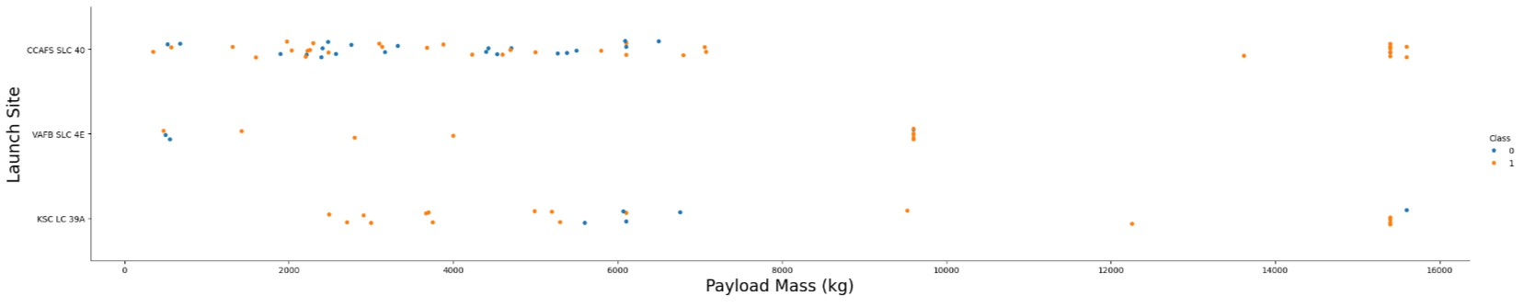
Payload vs. Launch Site
This plot shows the successful and unsuccessful landing outcomes for each launch site depending on the mass in kg of the payload the rocket was carrying.

Slide 20
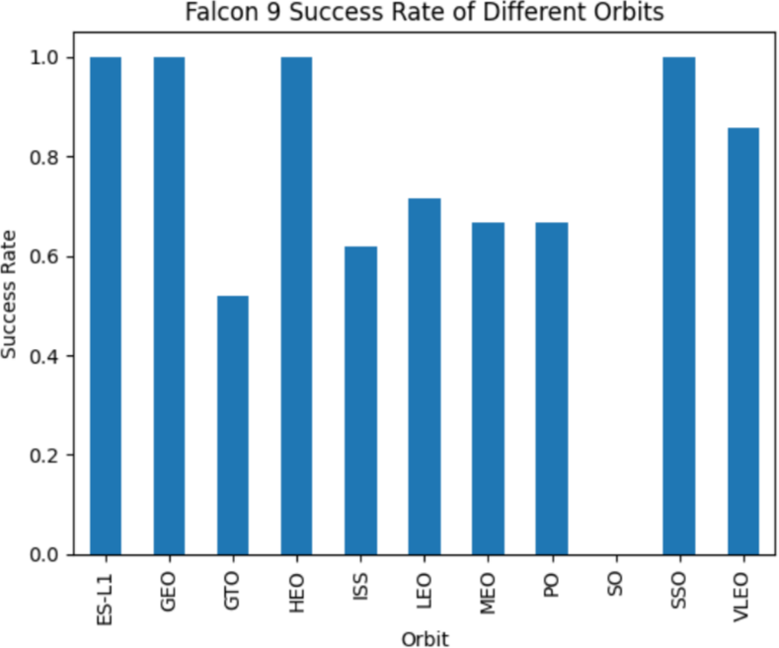
Success Rate vs. Orbit Type
The bar chart on the right shows the successful landing rate for each orbit that the Falcon 9 rockets reached.
20

Slide 21
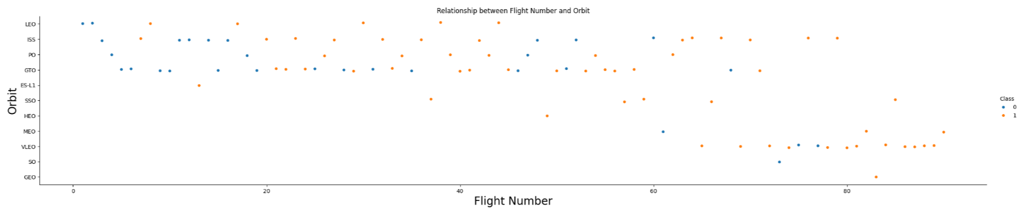
Flight Number vs. Orbit Type
Above shows the landing outcome based off relationship of the flight number and
the orbit the Falcon 9 reached.

Slide 22
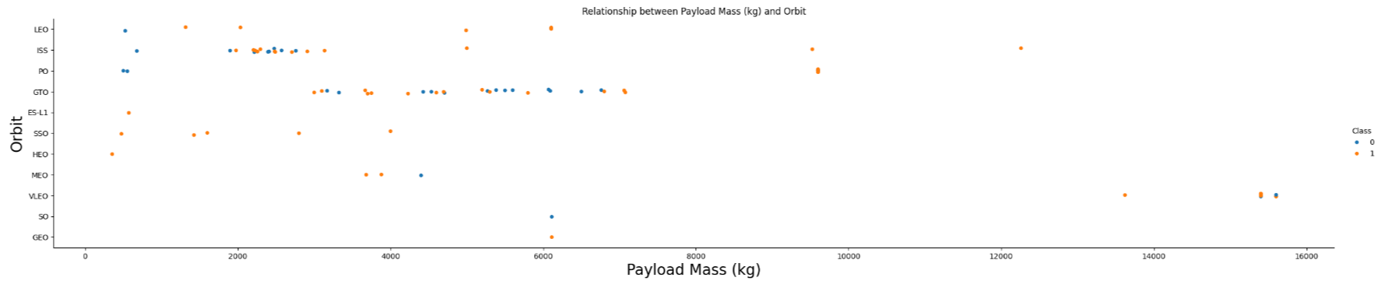
Payload vs. Orbit Type
This plot shows the landing outcome based on the relationship between the payload mass the Falcon 9 was carrying and the orbit the rocket reached throughout the flight.

Slide 23
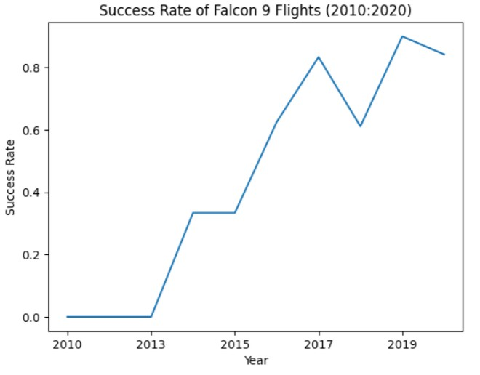
Launch Success Yearly Trend
The graph on the right shows the Falcon 9 landing outcome success rate for each year from 2010 to 2020

Slide 24
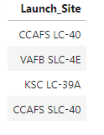
All Launch Site Names
SQL was used to find a list of all the launch sites the Falcon 9 flights

Slide 25
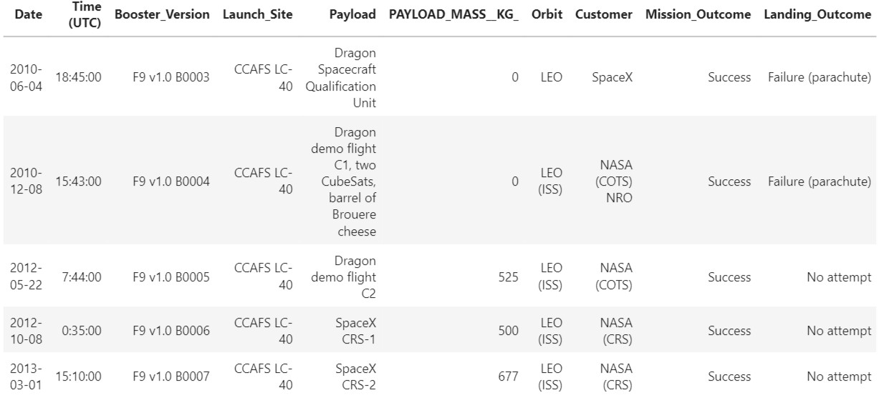
Launch Site Names Begin with 'CCA'
Below is a list of 5 records where the Launch Site begins with ‘CCA’

Slide 26
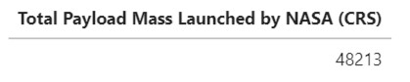
Total Payload Mass
Using SQL, the total payload mass (kg) launched by NASA (CRS) is shown below:

Slide 27
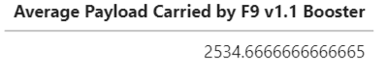
Average Payload Mass by F9 v1.1
SQL was able to calculate the average payload mass carried by the F9 v1.1 booster version.

Slide 28
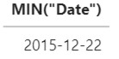
First Successful Ground Landing Date
The first ever successful ground landing occurred:

Slide 29
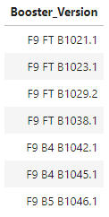
Successful Drone Ship Landing with Payload between 4000 and 6000
On the right is a list the boosters which have successfully landed on drone ship and had payload mass greater than 4000 but less than 6000.

Slide 30
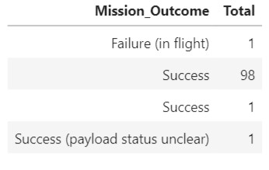
Total Number of Successful and Failure Mission Outcomes
Listed below are the successful and failure missions.

Slide 31
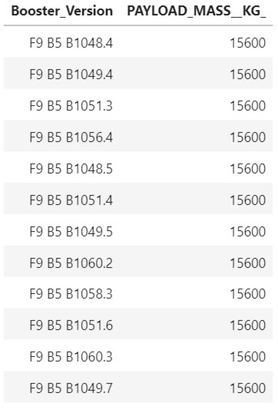
Boosters Carried Maximum Payload
The list on the left shows the different booster versions that have carried the highest payload by a Falcon 9 rocket.

Slide 32
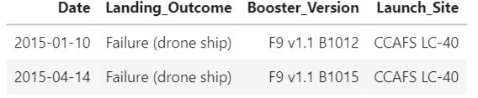
2015 Launch Records
There were only two times during 2015 where the Falcon 9 failed to land on a drone ship.

Slide 33
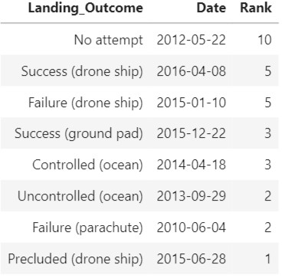
Rank Landing Outcomes Between 2010-06-04 and 2017-03-20
The count of landing outcomes between the date 2010-06-04 and 2017-03-
20, ranked in descending order

Slide 34

Section 3

Slide 35
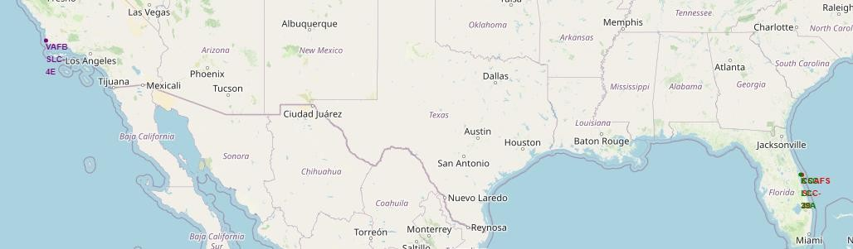
All Falcon 9 Launch Site
Shown below is a map of all the Falcon 9 launch site. All sites are located neat the coast in the southern half of the United States. KSC LC-39A, CCAFS LC-40, and CCAFS SLC-40 are all located in Florida while VAFB SLC-4E is in California.

Slide 36
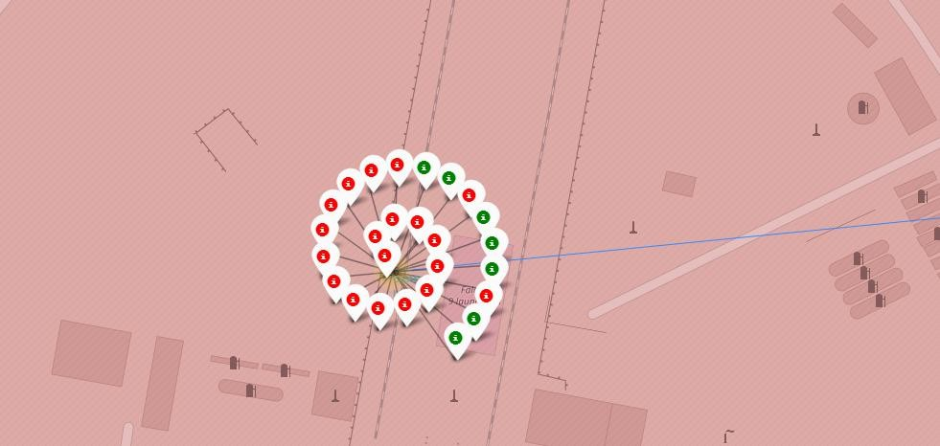
Launch Outcomes of CCAFS LC-40
Below shows the number of launches, color coded for successful (green) and failed (red) launches

Slide 37
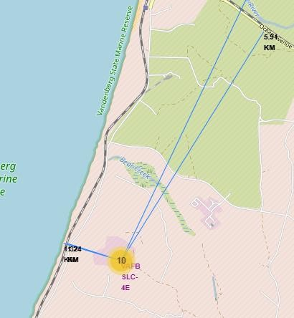
VAFB SLC-4E Relations to Landmarks
VAFV SLC-4E is located roughly
1.32 km from the pacific coastline, 1.24km from the US Santa Barbara Railroad, 5.91 km from Ocean Avenue highway, and 38.14 km from the city of Santa Maria.

Slide 38

Section 4

Slide 39
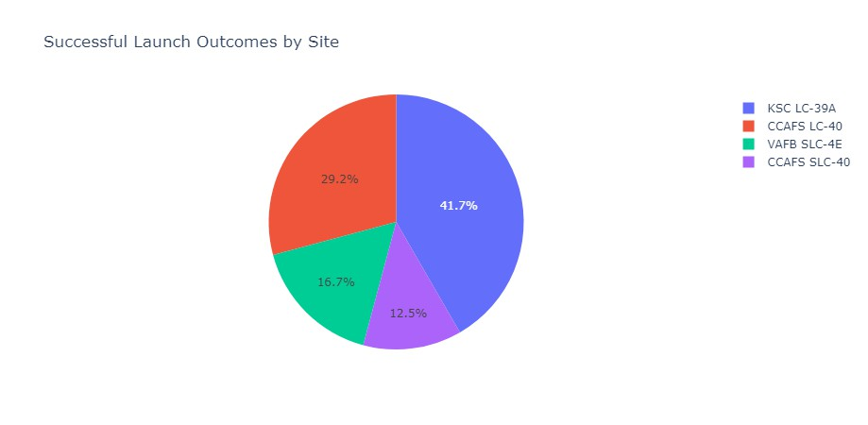
Successful Launches by Launch Site
For all the successful launches, KSC LC-39A has the most successful launches compared to its peers

Slide 40
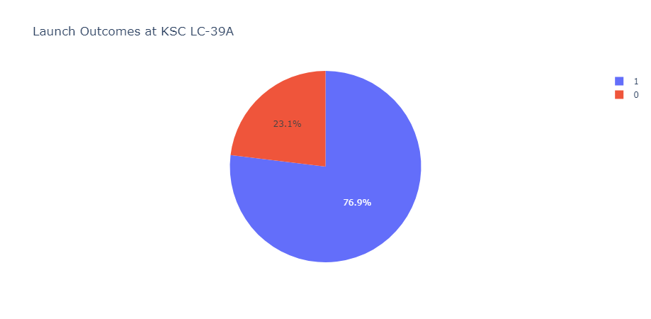
KSC LC-39A
Not only has KSC LC-39A had the most successful launches compared to the other
launch sites, but it also demonstrates the highest success rate of all the sites.

Slide 41
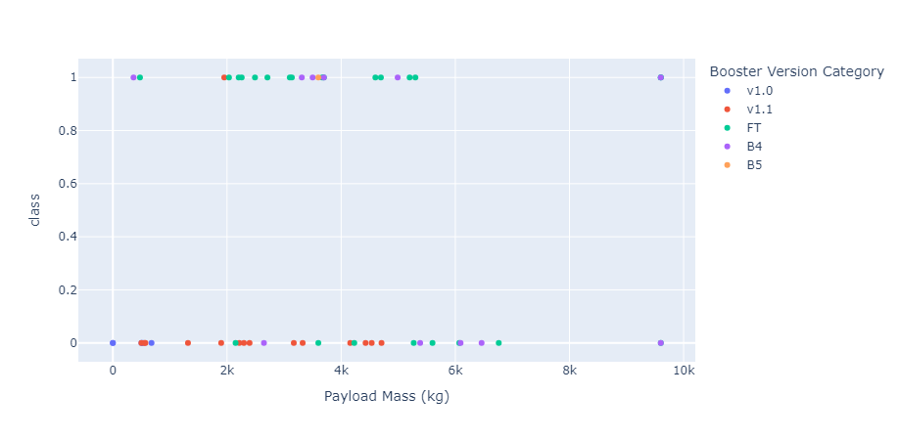
Success Outcome of Booster with Different Payloads
The FT booster has shown the most success for landing outcomes, especially for the
payload mass range of 2000 to 4000 kg.

Slide 42

Section 5

Slide 43




Classification Accuracy
K-Nearest Neighbor
The testing outcomes for all algorithms used resulted in an 83.33% accuracy.
The training accuracy was the determining factor that showed any difference in accuracy.
Decision Tree
The best was the Decision
Tree model.
80.00%
82.00%
84.00% 86.00% 88.00%
Training Accuracy
90.00%
Testing Accuracy
43

Slide 44
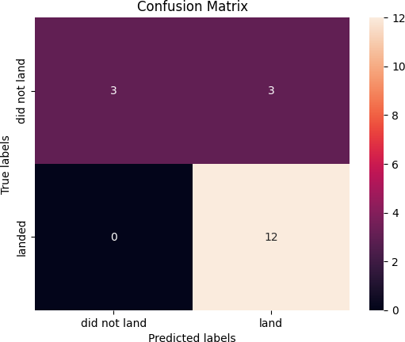
Confusion Matrix
The Decision Tree confusion showed good accuracy but did result in 3 false positive landing outcomes.
Tweaking some of the training variable might improve the overall accuracy of testing outcomes.
44

Slide 45
Conclusions
The testing outcomes for all models resulted in an 83.33% accuracy predicting
successful/unsuccessful landing outcomes.
Adjusting training/testing data splits and model variables could potentially improve testing outcome accuracy
Overall, the models produce good predictions of landing outcome. However, false positives were observed.
As more launches occur the models should improve.

Slide 46
Appendix
For a complete review of all the notebooks used in this Capstone Project please
refer to the following website:
DanishNurhira/Capstone-Project-Coursera (github.com)

Slide 47


